Slide 1



Audio-Visual Instance Discrimination with Cross-Modal Agreement
Shreya
Authors: Pedro Morgado, Nuno Vasconcelos, Ishan Misra
Deep
Team: TriVachan
Neilabh
Notes:
Author name

Slide 2

Outline
Overview
CMA
AVID
Result and Discussion
Concept and motivation
Objective & Ablation study
Training and types
Two downstream tasks

Slide 3



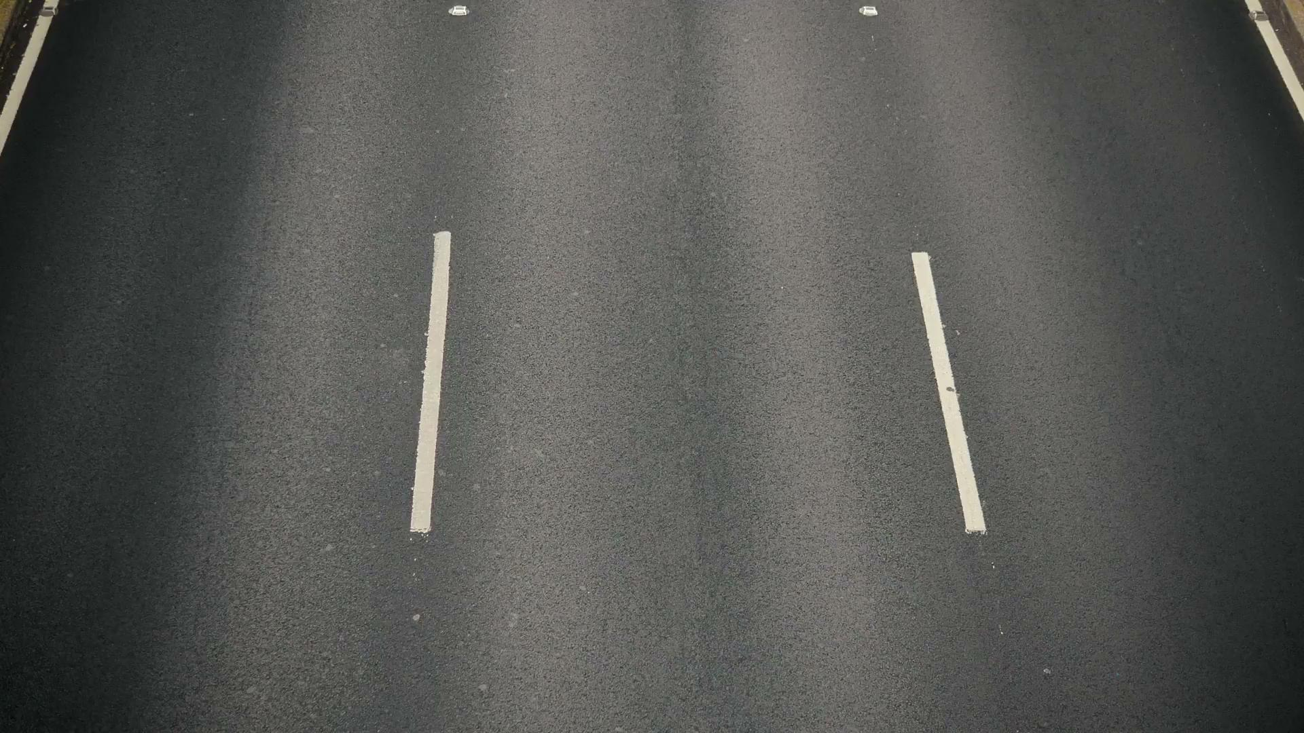
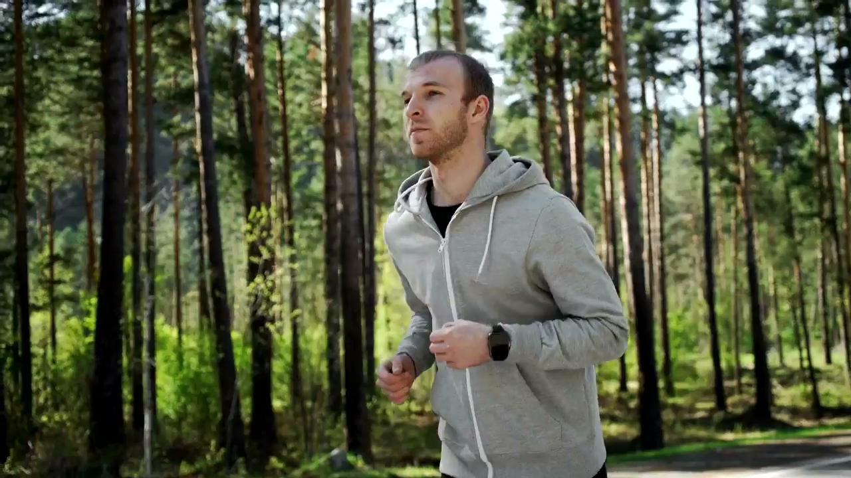
Introduction
Consider this audio Which video could have produced it?
Link
Link
Link
Notes:
Humans can connect a sound to multiple related image contexts. These associations between image and audio can be used for representation learning for videos. With this thought in mind, the aim of the paper is to learn audio-video representations in a self-supervised manner.
https://drive.google.com/file/d/1Uo3eB3PA7aK_LFBjhGEcGLVZi45sopPq/view?usp=sharing
https://drive.google.com/file/d/1aEOVQ0-NxxDyL3kmRVbjzzMLpChoPI0I/view?usp=sharing
https://drive.google.com/file/d/1dkUt5RiAYHAclxBOHJhA01QeqvUpq1KK/view?usp=sharing
AVID task define
Instance discrimination
Cross Modal and within modal

Slide 4
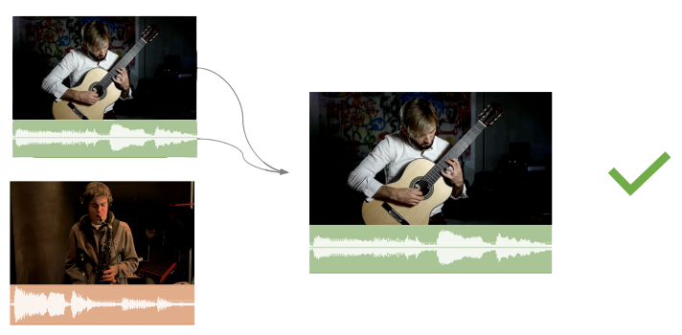
Audio - Visual Correspondence
Notes:
This approach to learn audiovisual representation is not new. Prior work framed it as audio visual correspondence tasks, wherein the model tries to align the visual and audio inputs by solving a binary classification problem. These methods use only a single audio-video pair at a time for learning and do not utilise the entire collection and cannot learn distribution at large.

Slide 5
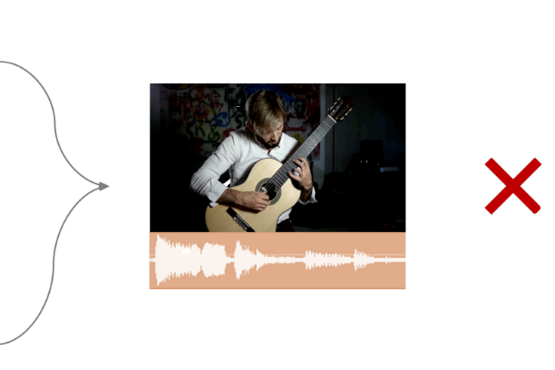
Audio - Visual Correspondence
Notes:
Negative audio-video pairs are often too easy. If given the video above, and audio from different section from same video, we do not want the audio to be identified as a match. These correspondence tasks are somewhat simpler.

Slide 6
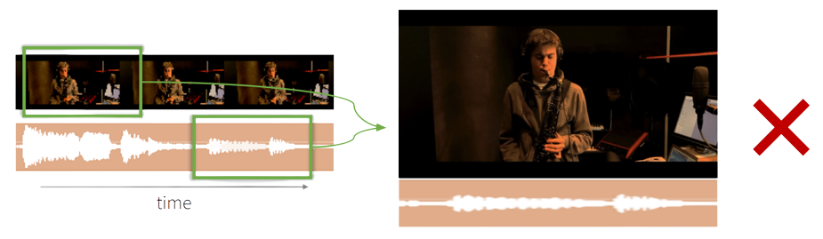
Audio - Visual Synchronization
Notes:
It has also been framed as a synchronisation task. This task can be solved easily by considering correlations in loudness and transitions in video and does not require to learn complex features.
Off-sync audio-video pairs are harder to spot.
However, synchronization can rely on correlations between loudness and movement, without learning more high-level semantic features

Slide 7
Are there other ways to increase the difficulty of the AVC task?

Slide 8
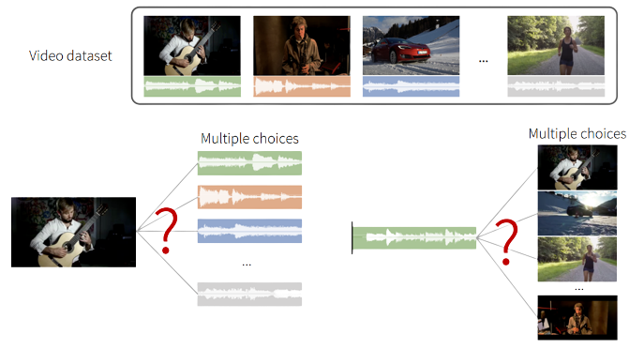
Audio-Visual Instance Discrimination
Notes:
This paper introduces a procedure which is inspired by contrastive learning that opposes large numbers of samples simultaneously. Given an audio, the network needs to select the corresponding video from the dataset. Conversely, given a video network is asked to select audio from the same instance. This task is termed as audio visual instance discrimination.

Slide 9
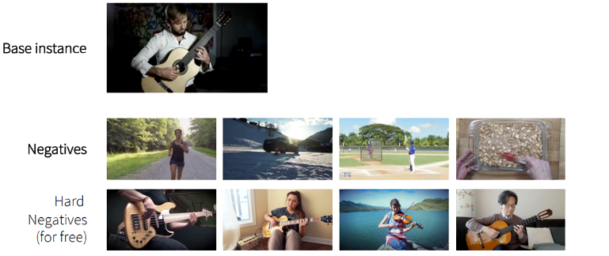
Audio-Visual Instance Discrimination
Notes:
As the number of negatives grows, the difficulty of some negatives increases naturally.

Slide 10
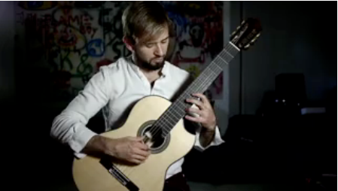
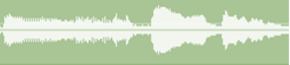
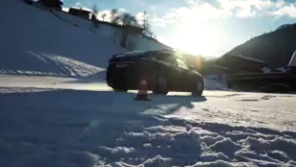
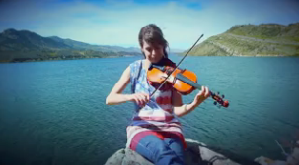
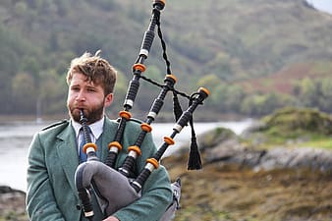
Audio-Visual Instance Discrimination
Common methods used are audio-visual verification task wherein the goal is to discriminate positive pairs from negatives to promote representation learning
Base audio
Positives:
Negatives:
Notes:
With more hard negatives, the model needs to learn cross-modal representations. This technique was seen to improve upon prior self-supervised methods on action recognition benchmarks like UCF-101 and HMDB-51.

Slide 11
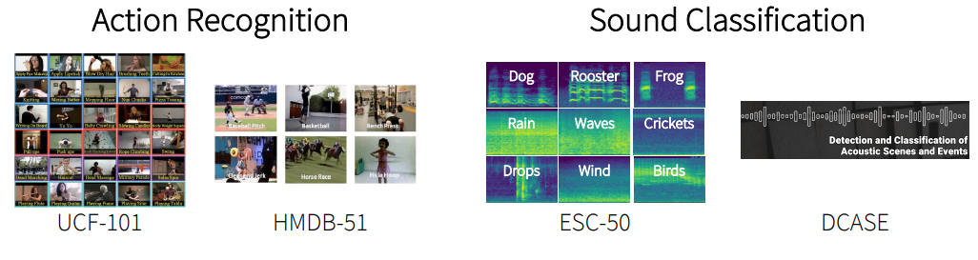
Downstream Tasks
Pre-trained models can be transferred to the downstream task by training a simple linear classifier
Notes:
The way we evaluate our representation model is to use them for obtaining feature vector and then train a linear classifier for downstream tasks which here are action recognition and sound classification.

Slide 12
Increasing number of negatives
Increasing Batch Size
Using Memory Banks^{[1]}
Loss fully differentiable
Loss Batch Size dependent
Distributed training req.
[1] Zhirong Wu et al. Unsupervised feature learning via non-parametric instance discrimination, CVPR, 2018
Loss Batch Size independent
# Negatives can be scaled
Size of Memory Banks
Notes:
The total number of negatives has increased compared to the single instance discrimination task described earlier. To accommodate this, we need new approaches.
Solution #1: Increasing the batch size
+ Loss is fully differentiable (allow back-propagation over anchors, positive and negative samples);
- Loss is batch size dependent;
- Requires distributed training for large number of negatives; which is difficult to handle
Solution #2: Using memory banks [1] - Zhirong Wu et al., 2018
+ Loss independent of batch size
+ Number of negatives can be easily scaled up without distributed training.
- Size of memory bank becomes prohibitively large for very large datasets (>100M samples).

Slide 13
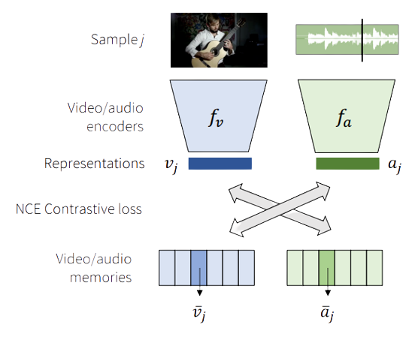
AVID - Training
R(2+1)D-CNN
2D-CNN
Notes:
Tran et al (2018) decomposed a 3D convolution into a 2D spatial convolution followed by 1D temporal convolution, which is named (2+1)D convolution. This, combined with a ResNet architecture gives the R(2+1)D-CNN video encoder.
The output of this encoder is the video representation, v_j
Audio files are pre-processed to generate log-spectrograms. These are passed through a 2D-CNN to get the audio representation, a_j
Using the Memory Bank model from the previous slide, we define the video/audio memories as the exponential moving averages of the video/audio representations.
Loss function for Representation Learning - Noise contrastive estimation [2] Gutmann & Hyvarinen (2010)

Slide 14
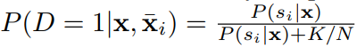
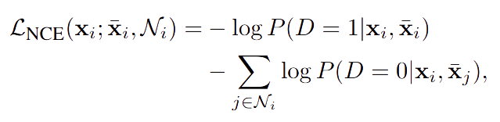
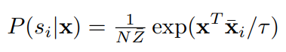
NCE Loss
(Noise Contrastive Estimation)
Notes:
Noise Contrastive Estimation
This is the standard log loss extended to all possible negatives
—----------------------------------------------------
K - negative samples in dataset
N - total samples in dataset
The probability of a feature x being from instance si as opposed to the instances from the uniformly sampled negative set Ni is given as P(D = 1|x, x¯i) = P (si|x) P (si|x)+K/N
The probability that a feature x belongs to sample si is modeled by a generalized softmax function
Tau is a temperature hyper-parameter that controls the softness of the distribution

Slide 15

Audioset is an audio event dataset, which consists of human-annotated 10-second video clips
Experimental Setup
Downstream Tasks -
Visual Features -
Kinetic Dataset for Action Recognition
Audio Features -
ESC-50 Dataset for Sound Classification
Dataset - Audio Set (Gemmeke et al, 2017)
1.8 million videos
Random subsampling (100k videos)
Video clips - 1 second long
Audio clips - 2 seconds long
Video - 16 frames (112x112)
Audio - spectrogram (100x129)
Notes:
We are going to look at some experiments to analyze various properties of the AVID task
This will allow us to understand the key factors that enable the different variants of AVID to learn good representations
Spectrogram - 100 time steps and 129 frequencies
—-------------------------------------------------------------------------------------------------------------------------------------------------------------
All models are trained with the Adam optimizer [39] for 400 epochs with a learning rate of 1e-4, weight decay of 1e-5, and batch size of 256.
In both cases, output activations are max-pooled, projected into a 128-dimensional feature using a multi-layer perceptron (MLP), and normalized into the unit sphere. The MLP is composed of three fully connected layers with 512 hidden units.
the normalized partition function Z¯ is approximated during the first iteration and kept constant thereafter (Z¯ = 2.2045).

Slide 16
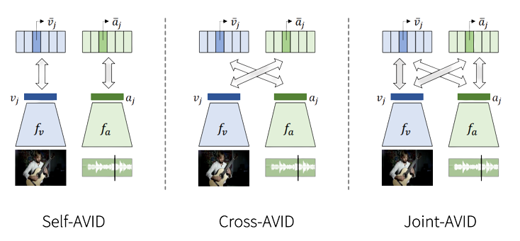
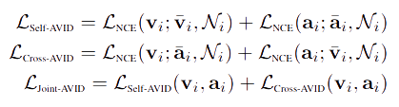
Within-modal vs cross-modal supervision
Notes:
We consider the following variants of the AVID task -
1. Self-AVID requires instance discrimination within the same modality - vi to vi_bar and ai to ai_bar.
2. Cross-AVID optimizes for cross-modal discrimination, i.e., the visual representation vi is required to discriminate the accompanying audio memory ai_bar and vice-versa.
3. Joint-AVID combines the Self-AVID and Cross-AVID

Slide 17
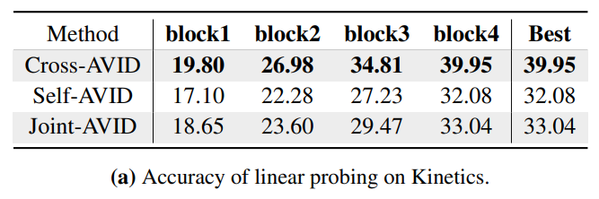
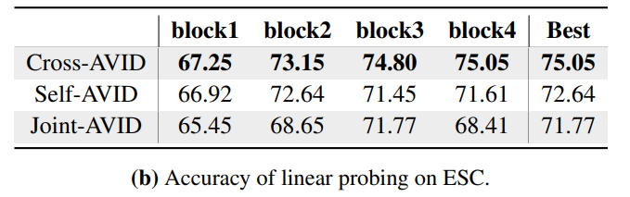
Cross vs within-modal instance discrimination
Self-AVID uses within-modality instance discrimination
Joint AVID also performs worse than Cross-AVID
Naive use of within-modality instance discrimination for AV representations is not enough
Notes:
We observe that Self-AVID is consistently outperformed by the Cross-AVID variant on both visual and audio tasks
We believe the reason is that Self-AVID uses within modality instance discrimination, which is an easier pretext task and can be partially solved by matching low-level statistics of the data.
This hypothesis is supported by the fact that Joint-AVID, which combines the objectives of both Cross-AVID and Self-AVID, also gives worse performance than Cross-AVID.
These results highlight that one cannot naively use within-modality instance discrimination when learning audio-visual representations.
In contrast, CrossAVID uses a “harder” cross-modal instance discrimination task where the video features are required to match the corresponding audio and vice-versa. As a result, it generalizes better to downstream tasks.

Slide 18
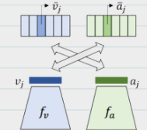
False negative sampling
Limitations of
Cross-AVID
Limited to instances
No within-modality calibration
Negative set may include instances semantically related to the current instance
Instance discrimination does not account for interactions between instances.
The Cross-AVID loss
does not directly optimize for visual similarity.
Notes:
Cross AVID performs best but there are certain limitations to Cross AVID:
First, it is ………….. Thus, two semantically related instances are never grouped together and considered ‘positives’.
Secondly, there is ……….. (which includes everything other than current instance)........This contradicts the goal of representation learning, which is to generate similar embeddings of semantically related inputs
Lastly, there is ……….. lack of within-modality calibration is problematic, as good visual representations should reflect visual feature similarities.
To make matters worse, contrastive
learning requires a large number K of negatives,
increasing the likelihood that semantically related samples
are used as negatives

Slide 19
Cross Modal Agreement (CMA)
‘Positive’ samples: instances that agree in both feature spaces
‘Negative’ samples: examples with a poor agreement in either (or both) spaces
Compared to instance discrimination methods
Larger positive set of semantically related instances
More reliable negative set
If two samples are similar in both visual and audio feature space, then they are more likely to be semantically related.
Notes:
So, We extend AVID with Cross-Modal Agreement (CMA) to address these shortcomings.
We hypothesize that ………..than samples that agree in only one feature space (or do not agree at all).
We define ‘positive samples’’ as ……. Negative samples as……..
Thus, compared to ……, CMA uses a larger ……. And a …….

Slide 20
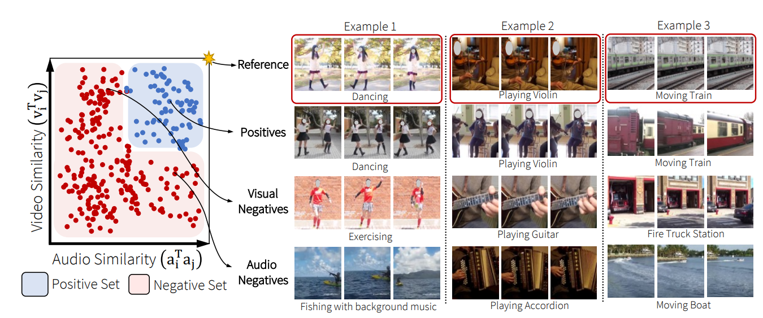
Visualizing Agreements
Notes:
Just to understand agreement better, let us look at this picture. I will focus on the example of dancing. Now, in CMA, positive set is the blue section only which has similar video and audio such as both dancing activity here. Visual negative are those having different audio but similar actions such as exercising here. Audio negatives are those having similar sound but different video. Thus we have a better positive set and a more reliable negative set by considering cross modal agreement.

Slide 21
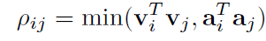
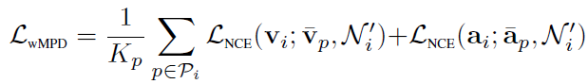
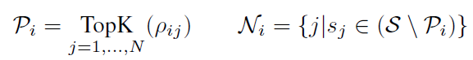
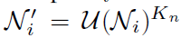
CMA Learning Objective
Positives and Negatives Set
Within-Modality Positive Discrimination
CMA Loss
Cross AVID Loss
Notes:
Moving on to learning objective, we define an agreement score pij for two instances si and sj. It is the minimum of audio or video representation similarity. This is large only when both the audio and video similarities are large.
Next, a set of positives and negatives is then defined per instance Si. The positive set Pi contains the samples that are
most similar to Si in both spaces, while the negative set Ni is the complement of Pi.
At training time, Kn negative instances are drawn per sample Si from the associated negative set Ni to form set Ni’.
So in our approach, the networks fv, fa shown earlier are learned to optimize a combination of cross-modal instance discrimination and within-modal positive discrimination (wMPD).
CMA defines multiple positive instances Pi, thus enabling the optimization of within-modality positive discrimination as can be seen in the LwMPD.
Unlike the Self-AVID loss term, this term calibrates within-modal similarities between positive samples. This avoids within-modal comparisons to the instance itself, which was experimentally shown to produce weak representations.
The cross avid loss used is same as before. So, our objective is to minimize the weighted sum of the two losses - cross modal and within modal where lamda is a hyperparameter.

Slide 22

04
Ablation Study

Slide 23
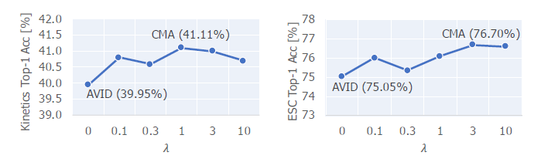
Linear probing- linear classifier for predicting which audio or video
ESC dataset is a labeled collection of environmental audio recordings
Kinetics dataset is a large-scale, high-quality dataset for human action recog in videos.
Advantage over Cross AVID
A network is pre-trained for different values of hyper-parameter and evaluated by linear probing on the Kinetics and ESC datasets.
Positive sample discrimination can further improve the performance of Cross-AVID.
Notes:
Now, moving on to ablation study to justify the weighted loss function.
We pre-train a network for ……….. And evaluate it by linear probing……..
As can be seen, the accuracy increases from a simple cross avid loss.
Since CMA identifies groups of instances that are likely related, we can say that calibrating within modal similarity within these groups (instead of within the instance itself) results in a better visual representation.

Slide 24
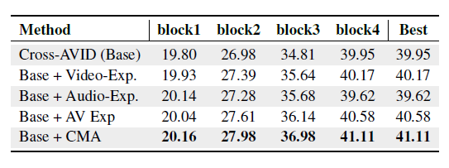
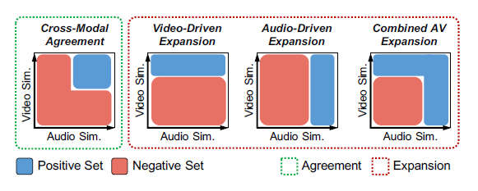
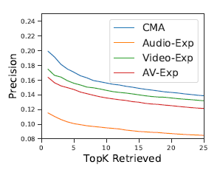
CMA vs Within Modal Expansion
Top-1 accuracy of linear probing on Kinetics.
CMA provides consistent gains over all methods on Kinetics
We compare all methods against the Cross-AVID baseline that uses only the instance itself as the positive set.
CMA finds more precise positives compared to within-modal expansion methods
Notes:
Next, We compare CMA to expansion methods that relate instances without modeling agreement. There are three other methods of expansion as shown in the figure. We com……………..
As can be seen, CMA provides consistent gains over all methods on Kinetics, suggesting that modeling agreement
can provide better positive sets for representation learning of visual features.
We can also see that Expansion methods generate agreements of worse precision. To understand this better, let us look at qualitative analysis.
(Compared to Cross-AVID, expanding the set of positives
using only audio similarity (third row) hurts performance
on Kinetics, and relying on video similarities alone (second
row) only provides marginal improvements. We believe that
expanding the set of positives only based on visual similarity
does not improve the performance of visual features since the
positives are already close in the feature space, and do not
add extra information.)
Top-1 accuracy is the conventional accuracy, model prediction (the one with the highest probability) must be exactly the expected answer.
A false positive is a “false alarm.” A false negative is saying something is false when it is actually true (also called a type II error)
Precision@k - In other words k is just the number of articles that you looked at, and Precision@k is the percentage of those articles that are relevant to you

Slide 25
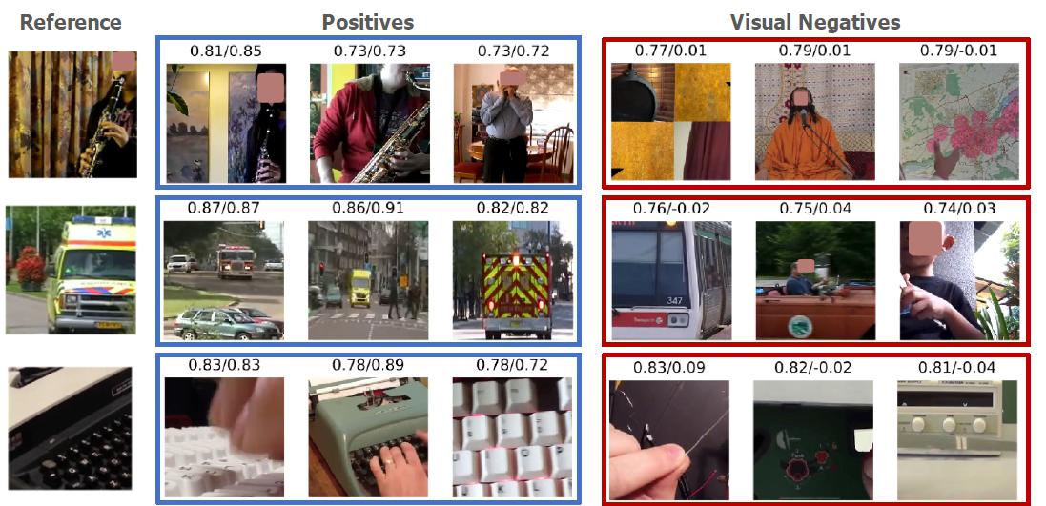
Qualitative Analysis
CMA can group together semantically related concepts.
Visually similar concepts, like ‘ambulance‘ and ‘bus‘ can be distinguished based on audio similarity
Thus more precise
Notes:
……………………………… Thus CMA has a higher precision than other expansion methods. Now Deep will present the results on downstream tasks.

Slide 26
05
Results and Discussion

Slide 27
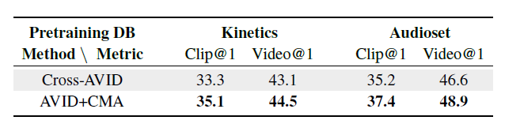
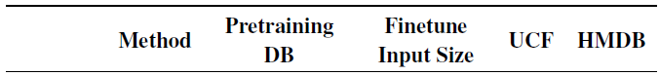
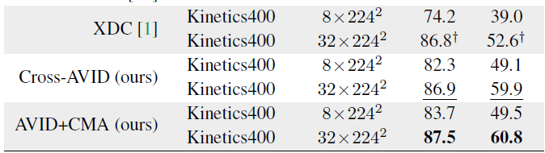
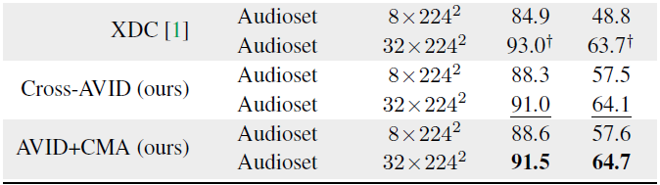
Setup
CMA vs Cross AVID in Action Recognition
18-layer R(2+1)D network is the video encoder and a 9-layer (2D) CNN with batch normalization is the audio encoder
Models are trained on Kinetics and Audioset datasets
Use CMA criterion to get positive sets
linear classifier is trained for the task of action recognition
Top 1 accuracy as metric
Notes:
We now show how the proposed methods fare on large-scale datasets and compare our model to previous literature. The setup is similar to before wherein we train pretrained networks for getting feature representation. For this kinetics and audioset datasets which is collection of videos with audio. Then classifier is trained for downstream tasks. The top-1 accuracy is reported for clip and video-level predictions. Clip-level predictions are obtained from a single 8-frame clip, while video-level predictions are computed by averaging clip-level predictions from 10 clips uniformly sampled from the whole video.
(We fine-tuned our models using clips with both 8 and 32 frames. At inference time, video-level predictions are provided by averaging clip-level predictions for 10 uniformly sampled clips [41]. We report top-1 accuracy averaged over the three train/test splits provided with the original datasets.)

Slide 28
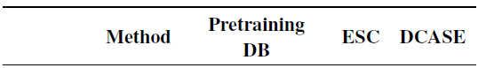
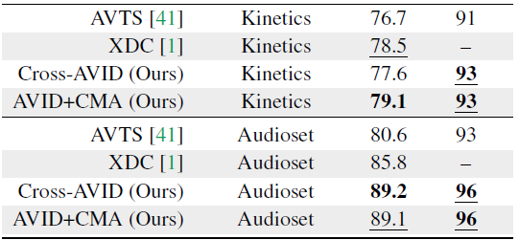
Sound Recognition Task
A linear one-vs-all SVM classifier is trained on the audio representations generated by the pre-trained models at the final layer before pooling
Notes:
Similarly for sound recognition task we see AVID+CMA performs better than other methods

Slide 29


Summary
CMA
CMA
CMA
CMA
Reject ‘false positives’, i.e., videos that are similar visually but differ in the audio space.
Improve visual and audio representations.
Relate multiple instances by identifying more related videos
Optimize for within-modal similarity, in addition to cross-modal similarity
Notes:
Our method outperforms prior work on action recognition and sound classification.
We also identified key limitations of the AVID model and improved by adding CMA which does calibration over instances from same positive set. There are 4 major advantages of CMA:
We propose and analyse multiple variants of avid task

Slide 30
Cross-Modal Agreements provide non-trivial correspondences
between samples and are a useful way to learn improved representations in a multi-modal setting.
Thanks!!

Slide 31
05
Extra

Slide 32
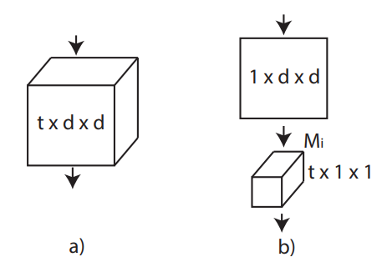
More on model
In simplified setting where the input is spatiotemporal volume with a single feature channel. (a) Full 3D convolution is carried out using a filter of size t × d × d where t denotes the temporal extent and d is the spatial width and height. (b) A (2+1)D convolutional block splits the computation into a spatial 2D convolution followed by a temporal 1D convolution. The numbers of 2D filters (Mi) is chosen so that the number of parameters in (2+1)D block matches that of the full 3D convolutional block.
ResNet inspired architecture.These convolutions over 3D reduces computational complexity, prevents overfitting, and introduces more nonlinearities that allow for a better functional relationship to be modeled.

Slide 33
pre-processing
the training set. Volume and temporal jittering for data augmentation. 1st by multiplying the audio waveform by a constant factor randomly sampled between 0.9 and 1.1, and applied uniformly over time. 2nd is done by randomly sampling the audio starting time within 0.5s of the video, and randomly selecting the total audio duration between 1.4s and 2.8s and rescaling back to the expected number of audio frames.
Video clips are extracted at 16 fps and augmented with standard techniques, namely random multi-scale cropping with 8% minimum area, random horizontal flipping and color and temporal jittering.
For audio, spectrogram is computed by taking the FFT on 20ms windows with 10ms or 20ms hop-size. Spectrogram converted to a log scale, and Z-normalize its intensity using mean and standard deviation values computed on

Slide 34
Implementation of CMA - Ablation study
After Cross-AVID pre-training, crossmodal disagreements are corrected by finetuning the audio and video networks to minimize the loss
Models are initialized with the Cross-AVID model at epoch 200, and trained for 200 additional epochs. We compare these models to a Cross-AVID model trained for 400 epochs, thus controlling for the total number of parameter updates
For each sample, we find 32 positive instances using the CMA
For efficiency purposes, the positive set is updated every 50 epochs.
In each iteration, 1024 negative memories (not overlapping with positives) were sampled.
These positive and negative memories were then used to minimize the CMA loss

Slide 35
Experimental Setup - Result
We use the 18-layer R(2+1)D network of as the video encoder and a 9-layer (2D) CNN with batch normalization as the audio encoder.
Models are trained on Kinetics-400 and the full Audioset datasets, containing 240K and 1.8M video instances
Video clips composed of 8 frames of size 224×224 are extracted at a frame rate of 16fps with standard data augmentation procedures.
Two seconds of audio is randomly sampled within 0.5 seconds of the video at a 24kHz sampling rate, and spectrograms of size 200 × 257 (200 time steps with 257 frequency bands) are used as the input to the audio network.
Notes:
UCF-101 is an action recognition data set of realistic action videos, collected from YouTube
HMDB51 is an action recognition dataset, collected from various sources, mostly from movies,

Slide 36
Parameters Setup - Result
For Cross-AVID, the cross-modal discrimination loss is optimized with K = 1024 negative instances.
We then find 128 positive instances for each sample using cross-modal agreements, and optimize the CMA criterion of with Kp = 32 positives, Kn = 1024 negatives and lambda = 1.0

Slide 37
Cross-Modal Deep Clustering (XDC), a novel self-supervised method that leverages unsupervised clustering in one modality (e.g., audio) as a supervisory signal for the other modality (e.g., video).
L3 and AVTS propose to learn audio-visual representations by predicting whether audio/video pairs are in-sync. However, these methods optimize for the audiovisual correspondence task, which fails to reason about the data distribution at large.

